Slide 1
Project proposal ( 1st semester)

Slide 2
Title:- SMART wear for blind
PURPOSE:Smart wear for people who are blind is an innovation which helps the blind people to navigate with speed and confidence by detecting the nearby obstacles using the help of ultrasonic waves and notify them with buzzer sound or vibration. They only need to wear this device as a band or cloth.
The first wearable technology for people who are blind
Using ultrasonic waves to detect the obstacles
Notifying the user through vibrations/buzzer sound

Slide 3
COMPONENTS USED:-
Arduino pro mini 328 5v/16MHz
Ultrosonic sensor.
Vibrating motor.
Buzzer.
5mm led .
Jumper wires.
Perfboard.
Switch.
5v/3.7v battery.
Male and female headers.

Slide 4
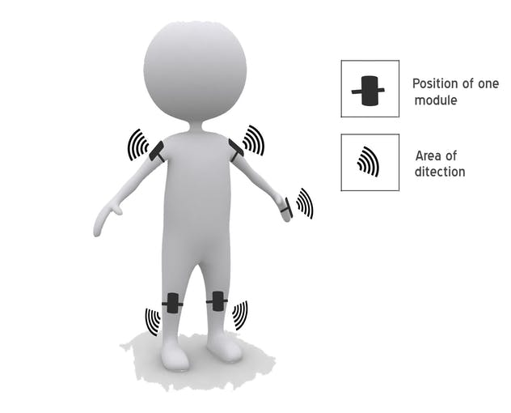
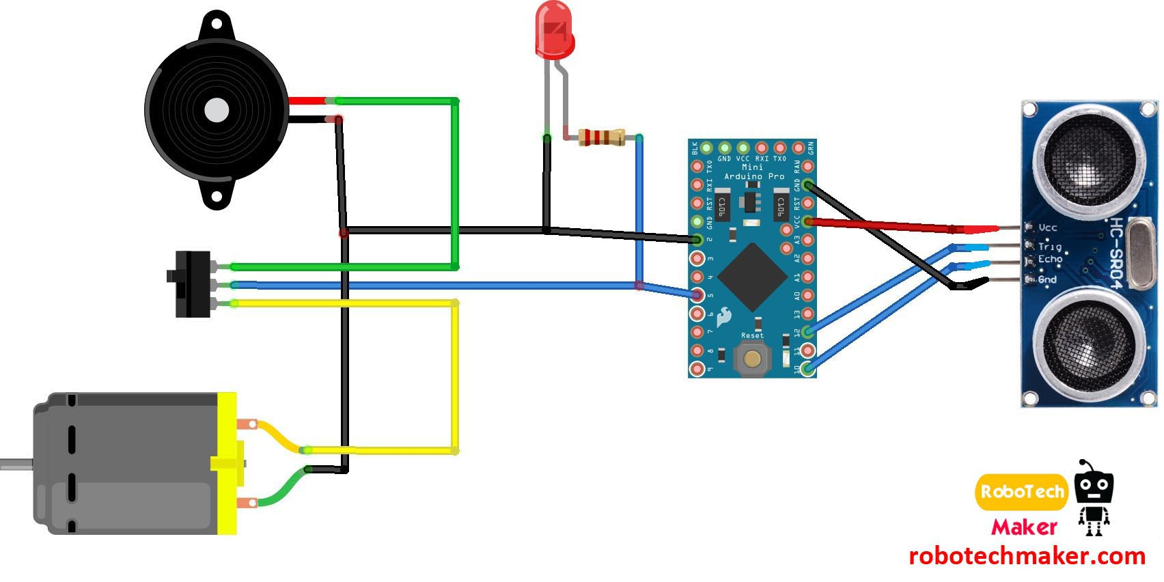
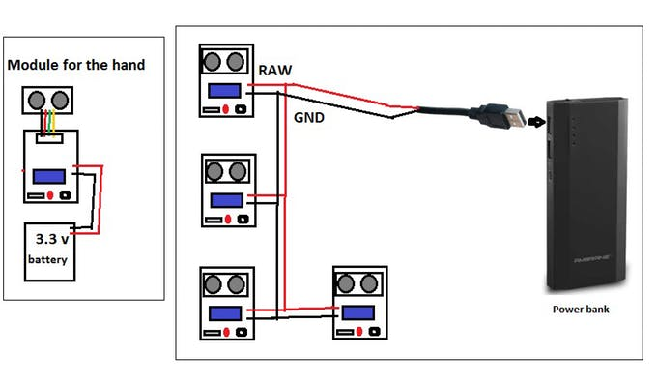
SOFTWARE USED :- Arduino IDE.
BLOCK DIAGRAM:

Slide 5
Implementation:- Step 1 :circuit connections
Ground of LED, buzzer and vibration motor to GND of arduino
+ve of LED and middle leg of switch to Arduino pin 5
+ve of Buzzer to first leg of switch
+ve of Vibration motor to third leg of switch
Ultrasonic sensor
Ultrasonic sensor pin VCC - Arduino pin VCC
Ultrasonic sensor pin GND - Arduino pin GND
Ultrasonic sensor pin Trig - Arduino pin 12
Ultrasonic sensor pin Echo - Arduino PIN 12
The switch used here is for selecting the mode. ( buzzer or vibration mode.)
Figure Powering the modules - Connect the 4 arduino pro mini to a USB male pin and connect to a power bank. For the module in the hand use a small lithium battery.

Slide 6
Step 2:-making of module
First cut the pref board in 5 X 3 cm dimension and solder the female headers for the Arduino to the board.
Then solder the buzzer.
Then connect the vibrating motor using the glue gun and solder wires to it.
Then connect the LED.
Then connect the switch.
Then connect header pins for ultrasonic sensors and for battery input.
Then solder everything as shown in the circuit diagram.
Now connect the Arduino and ultrasonic sensor to the board
Also connect the elastic band to all the modules.
3 more modules are to be made in the same way us described above, but for the one in the hand, there is a little difference. visit the next step before making that last module.

Slide 7
Step 3 :- coding of modules
Connect the ultrasonic sensor to the board by using 4 jumper cables.
Then connect a 3.7 volt mobile battery to this module.
Then connect the elastic band as shown in the figure.

Slide 8
Expected results
This is the first wearable technology for blind people which resolves all the problems of existing technologies. Now a days there are so many instruments and smart devices for visually impaired peoples for navigation but most of them have certain problems for carrying and the major drawbacks is those need a lot of training to use. The one of the main peculiarity of this innovation is, it is affordable for everyone, the total cost being less than $25 (~1500INR). There are no such devices available in the market that can be worn like a cloth and having such a low cost and simplicity. When used on a large scale, with improvements in the prototype, it will drastically benefit the community.

Slide 9
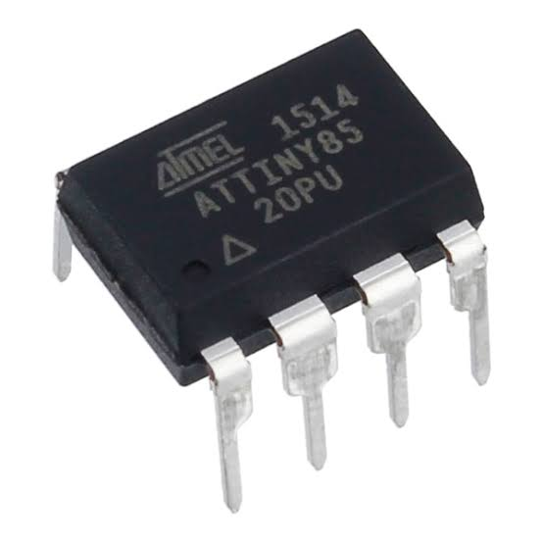
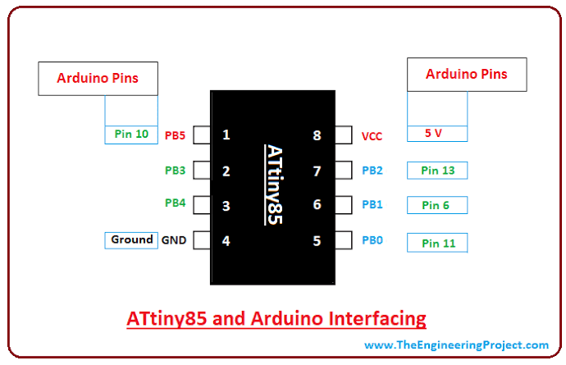
Future expansion of product

Slide 10
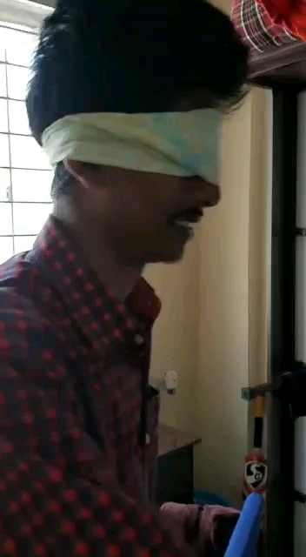
Working video

Slide 11
Thank
You

